Slide 1
Hotel Booking Demand
By: Thomas Simon

Slide 2
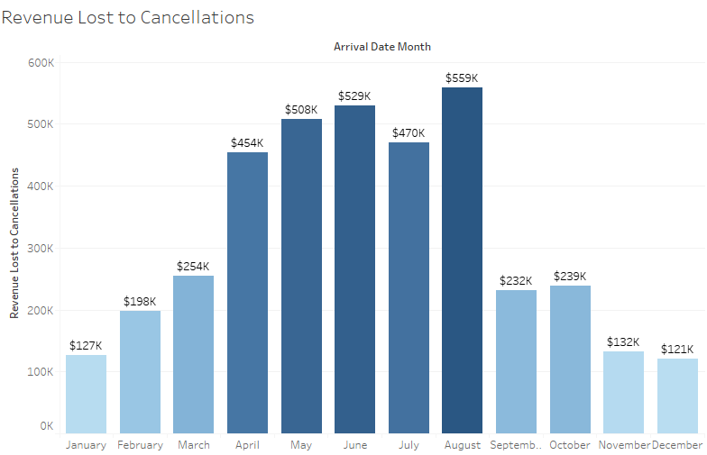
Hotel Cancellations are affecting revenue 2x worse in months April through August than in any of the other months.
Key Insight
Cancellations are noticeably happening during the summer months. Could this be because family plans keep changing?

Slide 3
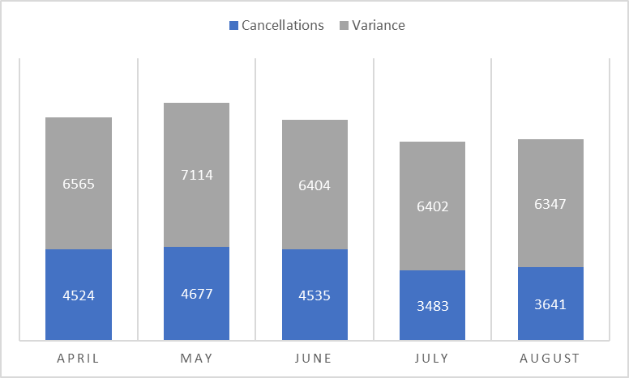
The number of cancellations for months April through August are as high 40% of total bookings.
Key Insight
From the summer months mentioned, we can see that there’s a total of 10k – 12k bookings occurring. With cancellations as high as 40%, maybe we could use the remaining 7 months as a guide to better understand and adjust operations to be less prone to cancellations.

Slide 4
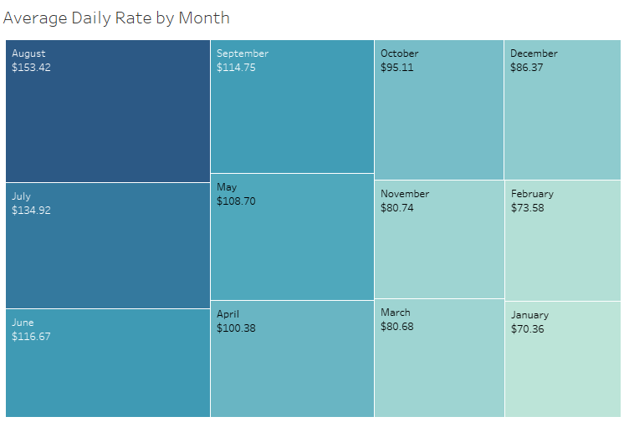
The top 6 most expensive months by the average daily rate noticeably includes April through August.
Key Insight
Looking at the treemap here, we can see that the average daily rates are highest for these same 5 summer months. We should investigate possibly decreasing rates. If we did, would this correlate with fewer cancellations? And if so, what percent reduction in cancellations would occur based on every dollar decreased?

Slide 5
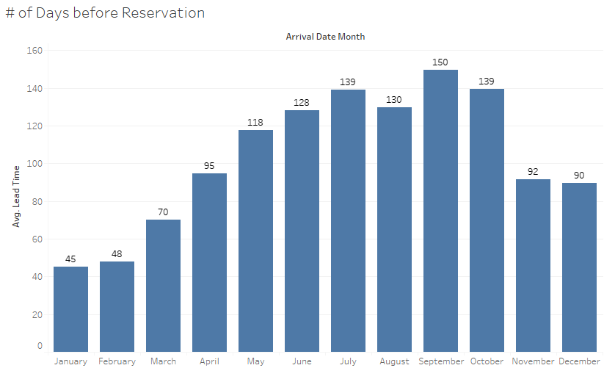
People are booking 1 to 1.5 months further in advance during summer months compared to any other time.
Key Insights
Does booking too far in advance correlate with a higher likelihood of a cancellation?
Why does September and October, the early autumn months, also have long lead times even though they’re not part of summer?

Slide 6
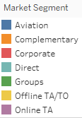
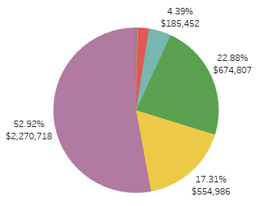
Online TA was contributing more than 50% to cancellations.
Key Insight
Online Travel Agents (TA) are responsible for over $2.2M in cancellations, almost 4 times the next largest. We should dive further into which agents specifically are the least effective and should be reconsidered as partners.

Slide 7
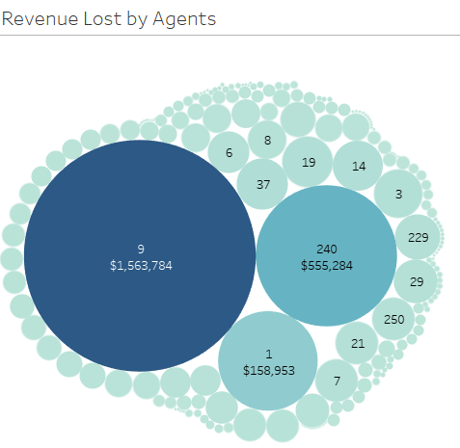
Agent #9 lost $1.5M in cancellations, nearly 3 times more than the next agent.
Key Insight
So now, looking at the agents, Agent #9 is the least effective partner as they’re losing a potential $1.5M in revenue through cancellations. We should reevaluate them as a partner and figure out why cancellations are so high through this avenue. It’s also worth noting that Agents #240 and #1 should be evaluated too since they seem to be notable outliers based on their revenue loss as well.

Slide 8
Recommendations
Look into summer months and see if longer lead times for customer bookings correlate with a higher rate of cancellations.
Consider reducing the average daily rates or offer promotions during the summer months to test whether cancellations will decrease.
With most cancellations coming from online travel agents, consider reevaluating Agents #9, #240, and #1 since they have the greatest revenue loss.

